Slide 1
Transformer
Seq2seq
Encoder

Slide 2

Sequence-to-sequence (Seq2seq)
Input a sequence, output a sequence.
The output length is determined by model.
Speech Recognition
Deep
Learning
Deep
Learning
深度学习
Machine
Translation
Speech
Translation
深度学习
(Chinese)

Slide 3
Seq2seq for Chatbot
“ Hi! How's your day going?”
Input
“Hey there!”
Seq2Seq
Reponse
[PERSON A:] Hey there!
[PERSON B:] Hi! How's your day going?
[PERSON A:] Pretty well, thanks! Just finished some work. How about you?
[PERSON B:] All good! I was about to settle in with a book. What do you do for work?
[PERSON A:] I'm a web designer. How about you? Do you work or study?
[PERSON B:] I'm actually a teacher, and I also have three kids to keep me busy. They're aged between 8 and 16.
[PERSON A:] Wow, that's quite the range. I don't have kids yet.
Training Data

Slide 4
Application of Seq2Seq
Most Natural Language Processing applications …
As long as transforming the task to Question Answering(QA)
QA can be done by seq2seq, tasks for example:
Syntactic Parsing
Multi-label Classification
Even: Obejct Detection
question/
context
Seq2Seq
answer

Slide 5
Seq2seq for Syntactic Parsing
Is it a sequence?
S
Model
Output
VP
NP
ADJV
Model
Input
deep learning is very powerful

Slide 6
(S
(NP
deep
learning
)
(VP
is
(ADJV
very
powerful
)
)
)
Seq2seq!
S
VP
NP
ADJV
deep learning is very powerful

Slide 7
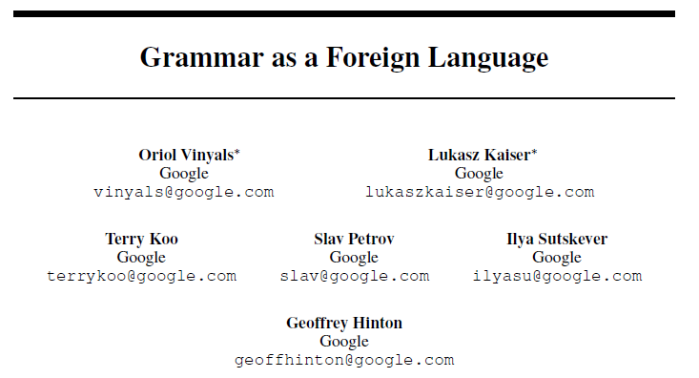
(S
(NP
deep
learning
)
(VP
is
(ADJV
very
powerful
)
)
)
https://arxiv.org/abs/1412.7449
deep learning is very powerful

Slide 8

Seq2seq for Multi-label Classification
An object can belong to multiple classes.
Class 1
Class 1
Class 3
Class 10
Class 1
Class 1
Class 3
Class 10
Class 3
Class 9
Class 3
Class 9
Class 17
Class 17
Seq2seq
Class 9
Class 7
Class 9
Class 7
Class 13
Class 13
https://arxiv.org/abs/1909.03434
https://arxiv.org/abs/1707.05495

Slide 9
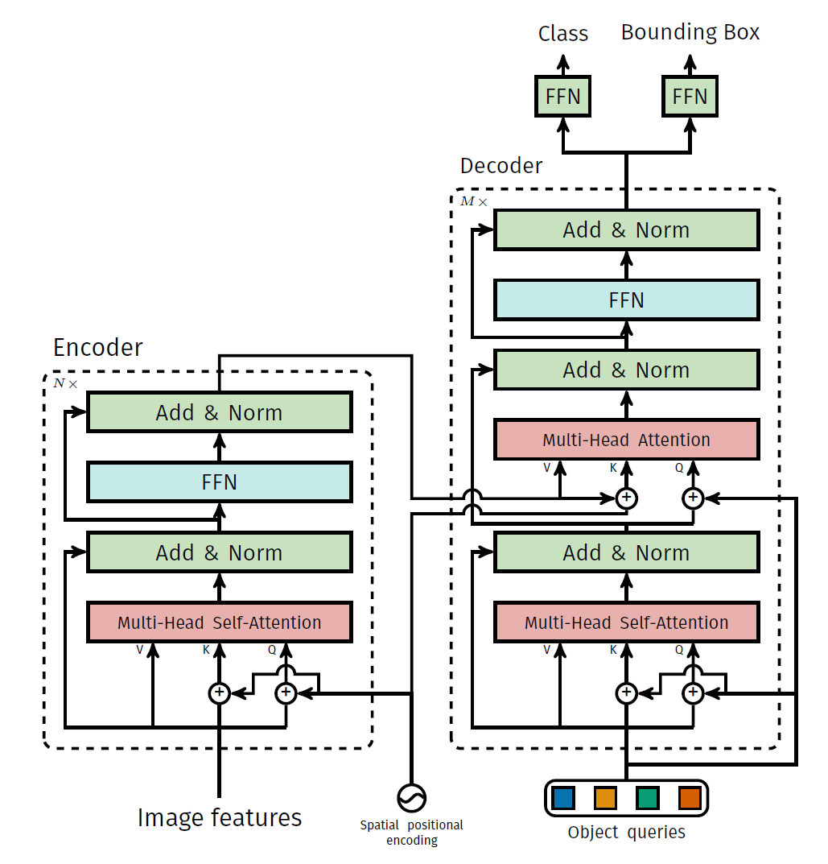
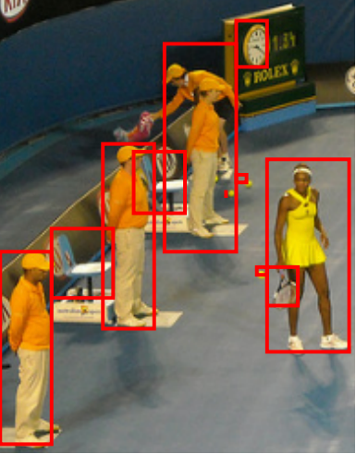
Seq2seq for Object Detection
https://arxiv.org/abs/2005.12872

Slide 10
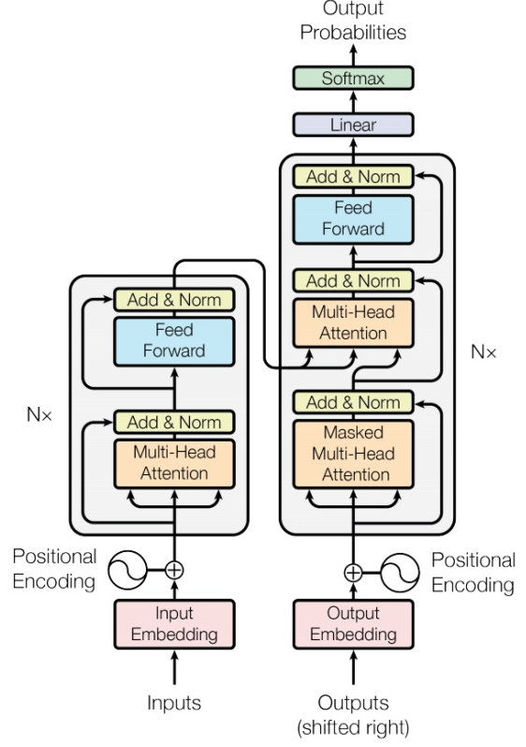

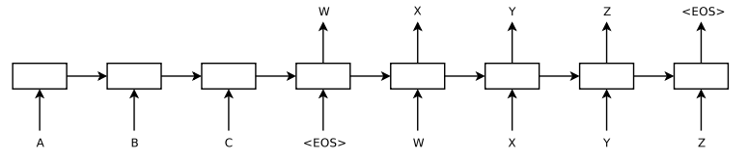
Seq2seq
output sequence
Encoder
Decoder
Input sequence
Sequence to Sequence Learning with Neural Networks
Sequence to Sequence Learning with Neural Networks
https://arxiv.org/abs/1409.3215
Transformer
https://arxiv.org/abs/1706.03762

Slide 11

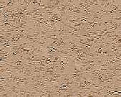
Encoder
output sequence
Encoder
Decoder
Input sequence
( I love machine learning )

Slide 12
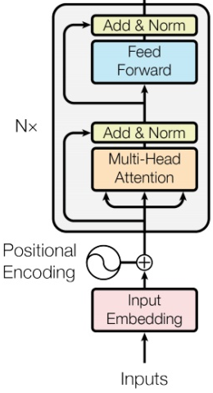








Encoder
Transformer’s Encoder
You can use RNN or CNN.
$$h^{1}$$
$$h^{2}$$
$$h^{3}$$
$$h^{4}$$
Encoder
$$x^{1}$$
$$x^{2}$$
$$x^{3}$$
$$x^{4}$$

Slide 13
$$h^{1}$$
$$h^{2}$$
$$h^{3}$$
$$h^{4}$$
Block
…
…
…
…
FC
FC
FC
FC
Block
Block
Self-attention
$$x^{1}$$
$$x^{2}$$
$$x^{3}$$
$$x^{4}$$

Slide 14






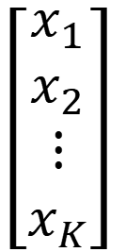


…
$$\left[\begin{aligned}x_{1}^{′} \\ x_{2}^{′} \\ ⋮ \\ x_{K}^{′}\end{aligned}\right]$$
$$x_{i}^{′}=\frac{x_{i}−m}{σ}$$
norm
norm
norm
Layer Norm
https://arxiv.org/abs/1607.06450
+
residual
$$a+b$$
$$\left[\begin{aligned}x_{1} \\ x_{2} \\ ⋮ \\ x_{K}\end{aligned}\right]$$
mean $m$
FC
standard deviation $σ$
$$b$$
+
$$a$$
Self-attention

Slide 15
$$h^{1}$$
$$h^{2}$$
$$h^{3}$$
$$h^{4}$$
Encoder
Residual
+ Layer norm
$$x^{1}$$
$$x^{2}$$
$$x^{3}$$
$$x^{4}$$

